Slide 1

Breast cancer prediction
Gourav Verma & Saurabh Biswas
DSC-630, Fall-2020
Bellevue University

Slide 2
Contents
Problem Statements
Proposal
Why Data Science
High Level Process Overview
Data
Data Cleaning & Exploratory Data Analysis
Model
Comparison
Test Results
Conclusion

Slide 3
Problem statements
Breast Cancer is 2nd most common cancer in women.
It is 2nd leading cause of deaths of women after lung cancer.
Is fine needle biopsy an effective tool in evaluating and diagnosing suspect lumps or masses?

Slide 4
proposal
Machine Learning Technique to Detect Women at Risk of Breast Cancer
Random Forest, Logistic Regression.
Training and Cross Validation.
Compare performance.
Select & Test the Best Model.

Slide 5
Why data science ?
Use Machine Learning to find out features that can lead to Breast Cancer
Machine Learning techniques minimize human intervention
Identify Women with Higher Risk at Breast Cancer
High Risk Group can take precautions and do regular checkups

Slide 6
Process overview
Gather Sample Data from Kaggle.
Perform Basic Analysis on the Data.
Split into Train & Test.
Carry Out Exploratory Data Analysis
Data Cleaning
Set up Pipeline for Model

Slide 7
Process overview
Parameter Tuning and Train Models.
Compare Cross Validation Matric.
Test the Best Model.
Set up Pipeline for Best Model
Train on Entire Dataset.

Slide 8
data
We are using the Wisconsin Breast Cancer dataset which was obtained from the University of Wisconsin Hospitals.
Diagnosis – Malignant (Cancer) & Benign (No Cancer)
31 features were computed for each cell nucleus
Important features
radius (mean of distances from centre to points on the perimeter)
Texture (standard deviation of grey-scale values)
Perimeter
Area
Smoothness (local variation in radius lengths)
Compactness (perimeter^2 / area - 1.0)
Concavity (severity of concave portions of the contour)
Concave points (number of concave portions of the contour)
Symmetry
Fractal dimension ("coastline approximation" - 1)

Slide 9
Data Cleaning & Exploratory Data Analysis
No Null Value
Dropped ‘id’ column
Converted ‘diagnosis’ variable values from M/B to 1/0
radius_mean, perimeter_mean & area_mean have higher correlation
radius_worst, perimeter_worst & area_worst have higher correlation
Diagnosis has higher correlation with perimeter_mean, concave points_mean, perimeter_worst, concave points_worst
Removed outliers for perimeter_mean, concave points_mean, perimeter_worst, concave points_worst

Slide 10
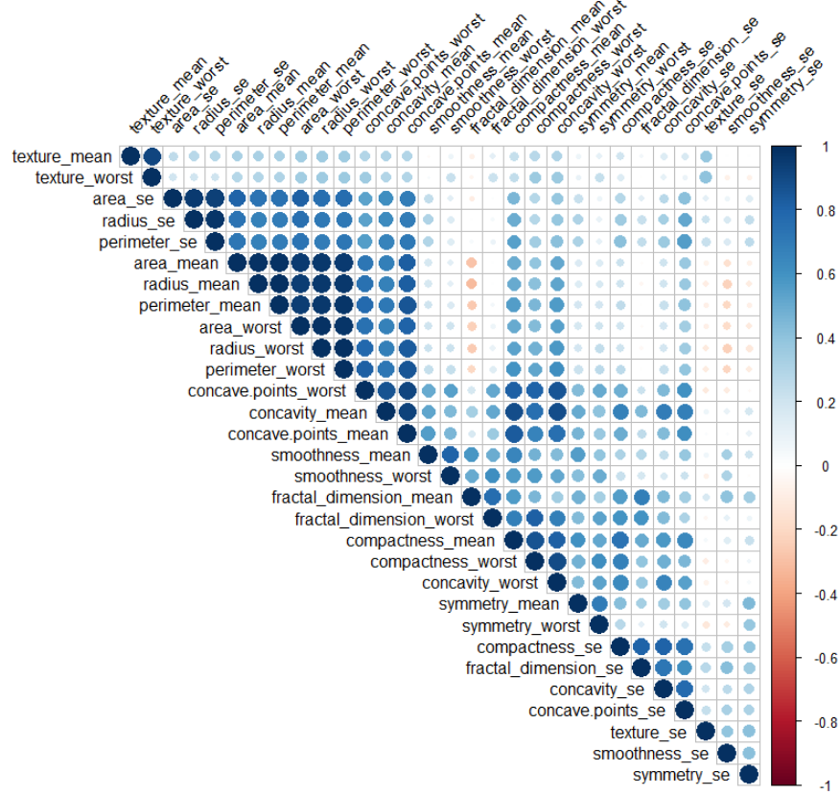
Correlation heat map

Slide 11
outliers

Slide 12
Pipeline setup – model
RF Pipeline with Seed
RF Parameter – Weight, Estimator, Features, Max_Depth
Logistic Regression Pipeline – SelectKBest, Weight, Seed
Logistic Regression Parameter – C, select best k

Slide 13
Model Cross Validation
Models a Tuned, Trained & Cross-Validated using GridSearchCV
RF is not Calibrated
Future Plan is to Calibrate RF
Selected RF based on Best Accuracy
Model | Best Parameter | Accuracy
RF | rf__class_weight: balanced rf__max_depth: 6 rf__max_features: sqrt rf__n_estimators: 100 | 0.964
LR | logistic__C: 10.0 select_best__k: all | 0.962

Slide 14
Model Test
Random Forest Confusion Matrix:
Logistic Regression Confusion Matrix:
 | Random Forest | Logistic Regression
Accuracy | 0.958 | 0.93
F1-Score | 0.944 | 0.907
TP: 86 | TN: 4
FP: 2 | FN:51
TP: 84 | TN: 6
FP: 4 | FN:49

Slide 15
Conclusion
RF performed best
RF is like Decision Tree – so it can be easily explained
We choose RF as our final model

Slide 16

Thank you

